Slide 1

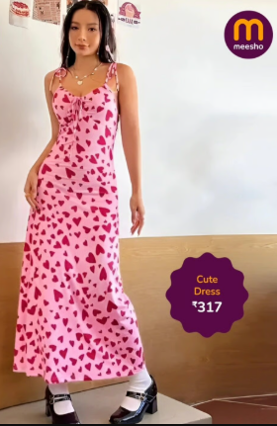
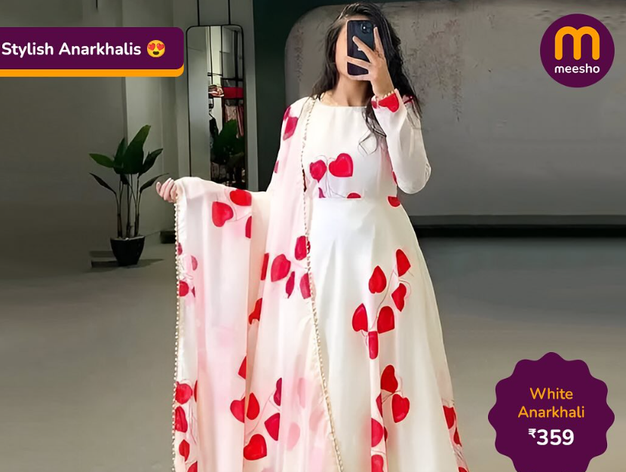
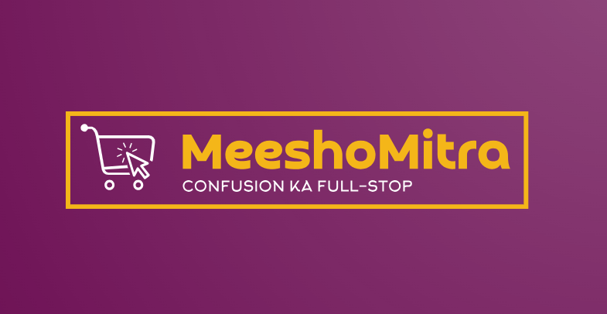

MEESHO MITRA
AI-powered FAQ assistant
#TEAM LONELOOP : BY IDRA CHAUDHARY
#TEAM LONELOOP : BY IDRA CHAUDHARY
#TEAM LONELOOP : BY IDRA CHAUDHARY

Slide 2

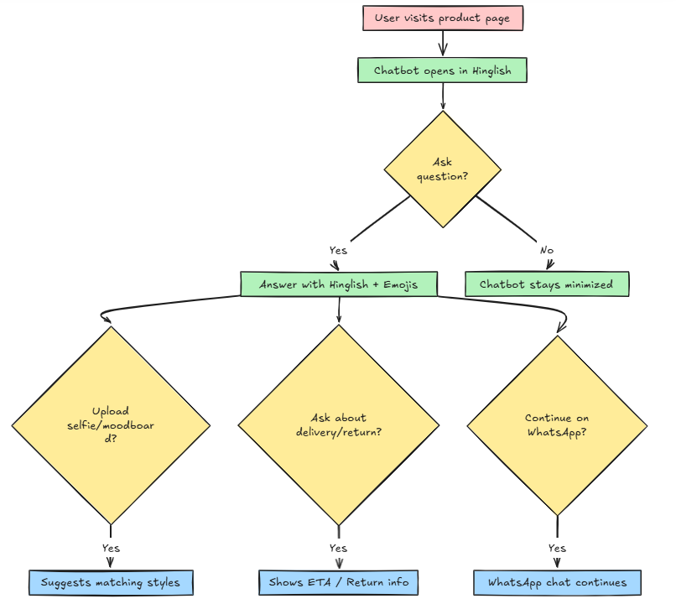
Theme Selection
Main Theme: Inclusive Digital Commerce
Sub-Theme (Custom): Humanizing Product Support for Bharat Users
Problem Context: FAQ sections on e-commerce platforms are:
Robotic and text-heavy
Poorly understood by Tier-2/Tier-3 audiences
Ineffective in reducing returns or boosting confidence
Alignment: Meesho Mitra replaces these static sections with a smart, emotional, Hinglish-speaking FAQ chatbot embedded inside product pages. It helps Bharat users:
Get clarity through conversation
Share selfies/moodboards
Ask personalized questions
Continue chats on WhatsApp

Slide 3

Problem Statement: Bharat users drop off or return Meesho orders due to:
Unclear fabric quality (Can’t touch/feel online)
Event mismatch (Unsure if "party wear" suits their occasion)
Style doubts (Will this color/fit flatter me?) Static FAQs fail to address these emotional, personalized queries.

Slide 4
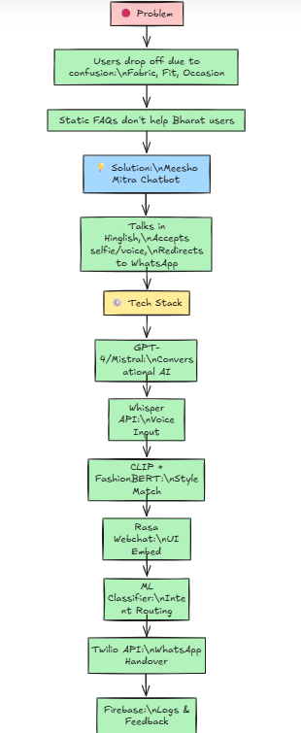
Solution:
Meesho Mitra – A Hinglish-speaking chatbot that revolutionize the FAQ:
Get Clarity Through Conversation
Asks simple, guided questions ("Kapde ka color photo jaisa hoga?").
Uses voice/text inputs for users uncomfortable with typing.
Share Selfies/Moodboards
Users upload photos ("Meri skin tone ke liye ye suit karega?") or inspiration images.
AI suggests products matching their needs.
Ask Personalized Questions
Context-aware replies (e.g., *"Ye fridge 5-member family ke liye enough hai?"*).
Compares products like a friend ("X vs Y, which is lighter for summer?").
Continue Chats on WhatsApp
Sends chat history to WhatsApp for offline help from family/friends.
Reduces drop-offs by meeting users where they are.
Why It Works for Bharat
Language: Responds in Hinglish ("Return kaise karna hai? Bas 3 steps!").
Emotional Tone: Warm, reassuring ("Tension mat lo, hum help karenge!").
Visual Aid: Supports images/voice for non-text users.
Impact:
Fewer returns (clear expectations)
Higher trust (human-like guidance)
More sales (personalized nudges like "Ye trending hai aapke area mein!")

Slide 5
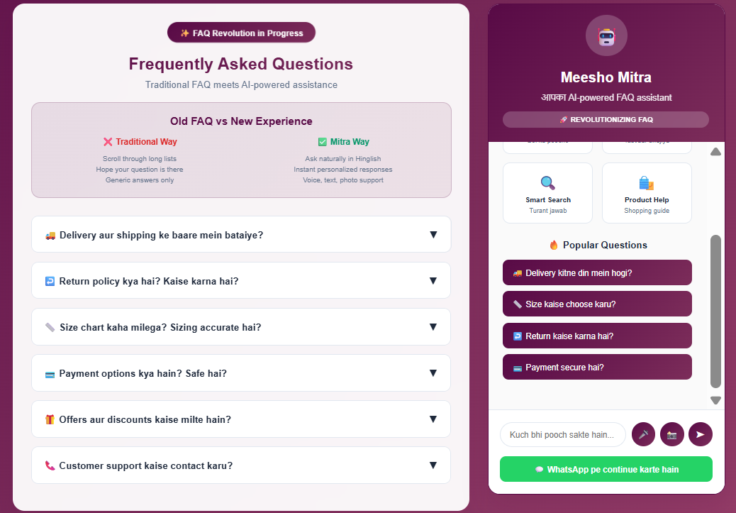
https://idrachaudhary.github.io/MeeshoMitra/

Slide 6
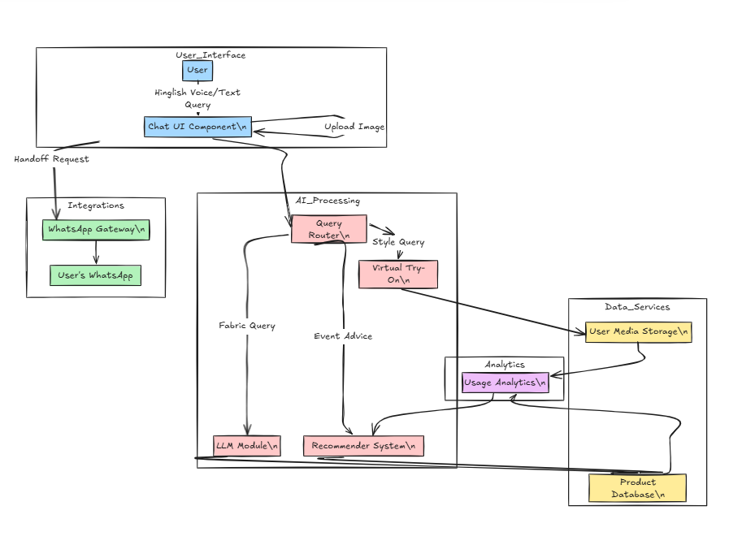
Technical Approach:
Conversational AI: GPT-4 / Mistral LLMs (Hinglish understanding & empathy)
Voice Input: Whisper API for multilingual voice-to-text
Chat UI: Rasa Webchat embedded in product page (React-based)
Query Routing: ML-based intent classifier (HuggingFace / sklearn)
Product Suggestions: Custom recommender using cosine similarity / Meesho APIs
WhatsApp Handover: Twilio API with pre-filled context
Logs & Analytics: Firebase for chat data and personalization

Slide 7
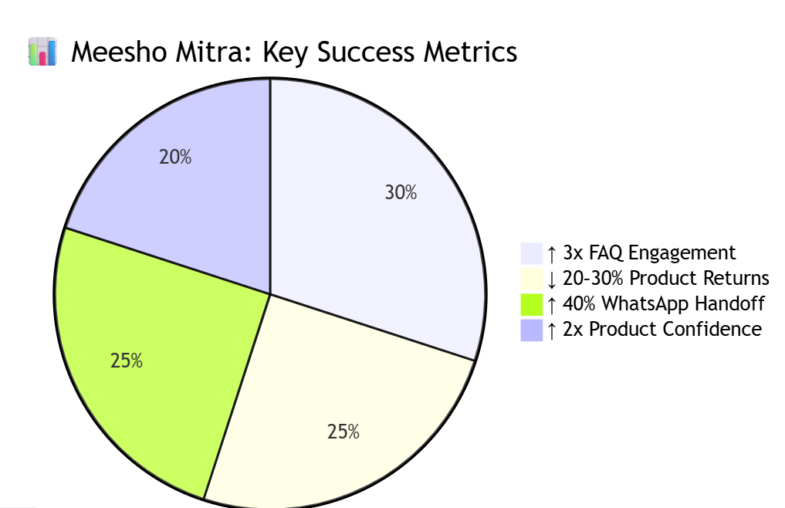
Core Innovation:
Conversational FAQs - Replaces text-heavy FAQs with simple chat (voice/text).
Example: "Is this suit good for monsoon?" → "Yes! Made with water-resistant fabric "
Visual Recommendations - Users upload selfies/moodboards to get tailored suggestions ("This color will match your skin tone!").
Category-Smart Help - Custom advice per category (e.g., saree draping tips, kurta length guide).
🇮🇳 Bharat-Readiness:
Hinglish-first UI
Mobile-friendly UX
Works with low data speeds
Familiar experience (chat + WhatsApp)
User Simplicity:
No scrolling — only conversation
Soft, supportive tone
3-click doubt resolution
Success Metrics(approx):
20–30% reduction in product return rate
3x increase in FAQ engagement
2x boost in pre-checkout product confidence

Slide 8
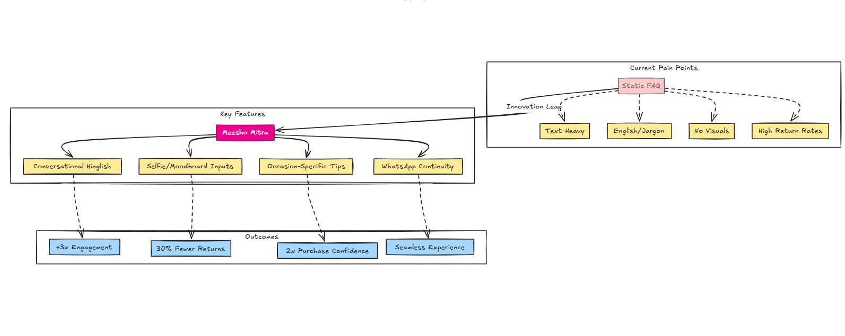
"Har sawaal ka jawab, doston jaisa pyaar." (Every doubt answered, with a friend’s love.)

